Slide 1
Lecture 9: Motion estimation
Most slides from S. Lazebnik, which are based on other slides from S. Seitz, R. Szeliski, M. Pollefeys
Notes:
3D reconstruction -> epipolar motion

Slide 2
Announcements
Please note the Piazza post is to clarify that you do not need to email me for extensions unless there is an extreme circumstance where you need support
No homework due this week - next week panoramas due
Proposal info out this week for the project
Notes:
Representation learning.
What representations are learned by deep nets?
Transfer learning: How you can transfer a representation from one task to another?
Finally: how can you learn representations?

Slide 3
Corners
https://web.eecs.umich.edu/~justincj/slides/eecs442/winter2020/442_WI2020_lecture09.pdf
Slides 43-61 for eigenvalue intuition, through 71 for Harris Detection

Slide 4
Motion

Slide 5
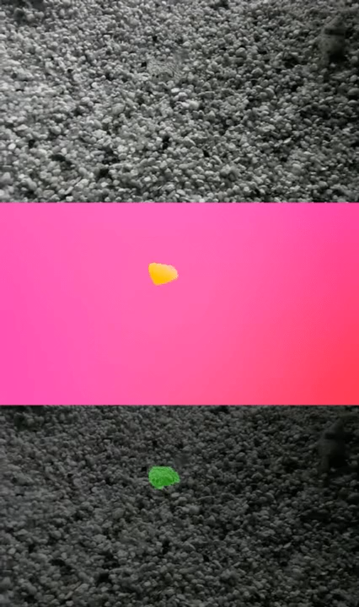
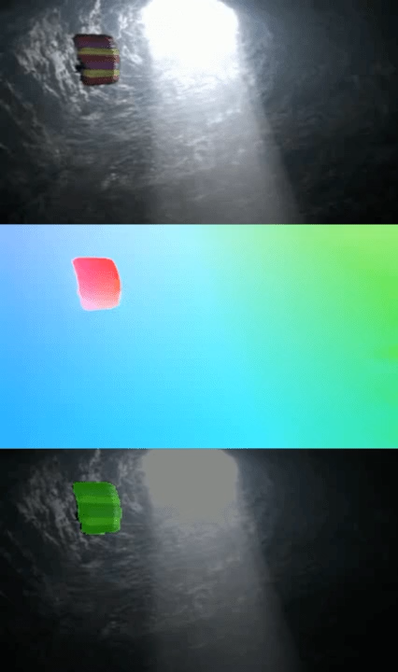
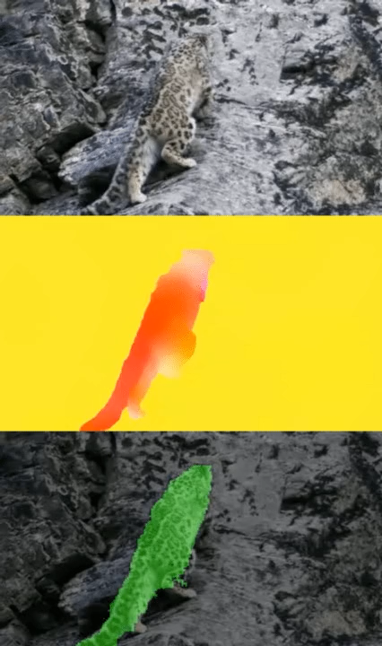
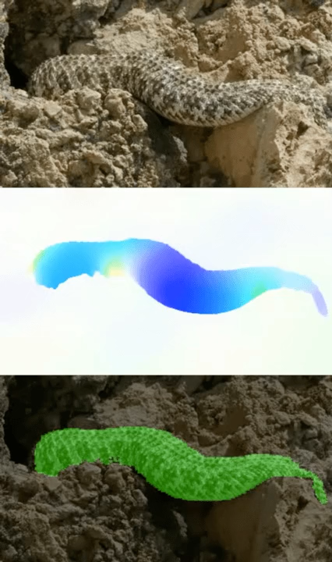
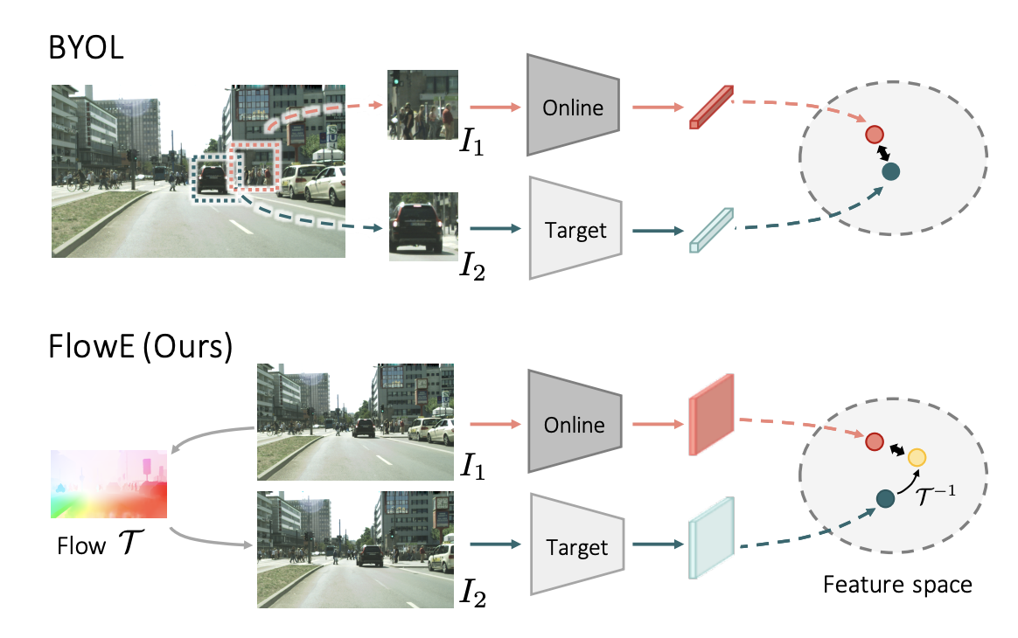
Motion is a powerful perceptual cue
[Yang et al., “Self-supervised Video Object Segmentation by Motion Grouping”, 2021]
Yuwen Xiong, Mengye Ren, Wenyuan Zeng, Raquel Urtasun. Self-Supervised Representation Learning from Flow Equivariance. arXiv 2021.

Slide 6
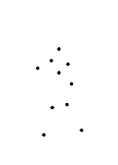
Motion is a powerful perceptual cue
G. Johansson, “Visual Perception of Biological Motion and a Model For Its Analysis", Perception and Psychophysics 14, 201-211, 1973.
Source: S. Lazebnik

Slide 7
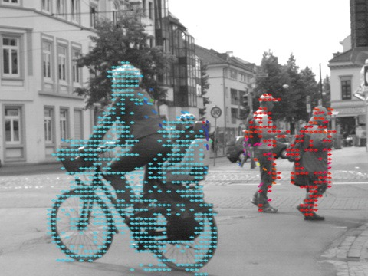
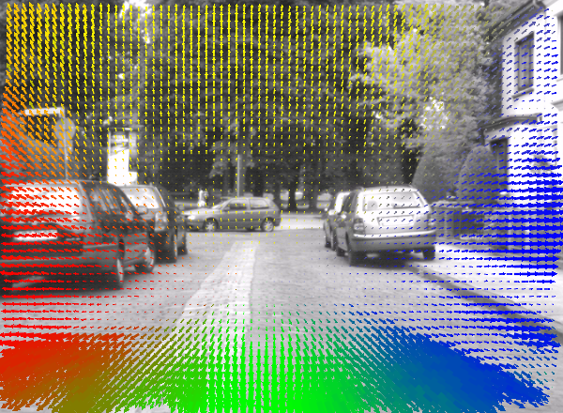
Optical flow
Optical flow is the apparent motion of brightness patterns in the image
  Can be caused by camera motion, object motion, or changes of lighting in the scene
Image source
Image source
Source: S. Lazebnik

Slide 8
Estimating optical flow
I(x,y,t–1)
I(x,y,t)
Given two consecutive frames, estimate the motion field u(x,y) and v(x,y) between them
How can we estimate it? Some assumptions:
  Brightness constancy: projection of the same point looks the same in every frame
  Small motion: points do not move very far
  Spatial coherence: points move like their neighbors
Source: S. Lazebnik

Slide 9


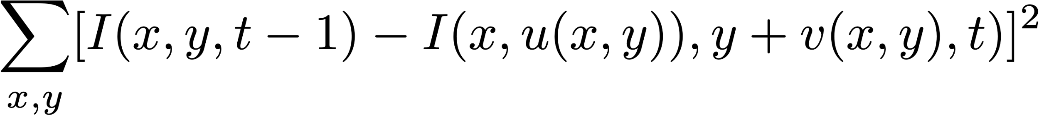
The brightness constancy constraint
I(x,y,t–1)
I(x,y,t)
Simple loss function [Lucas & Kanade 1981]. Find flow that minimizes:
Source: S. Lazebnik

Slide 10


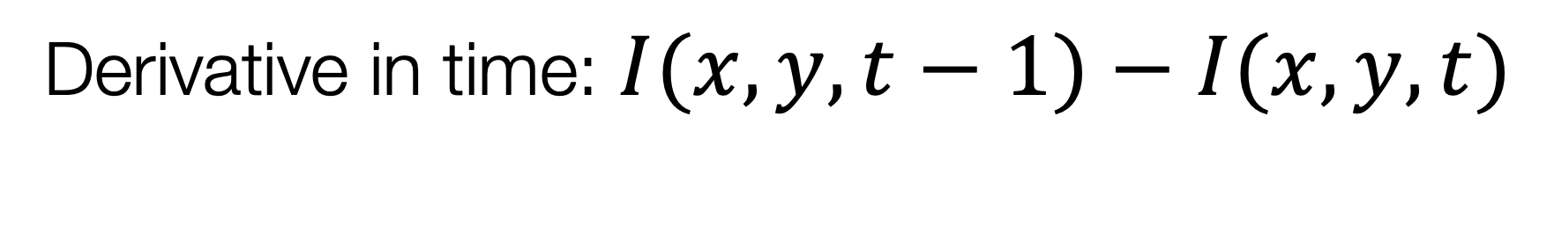
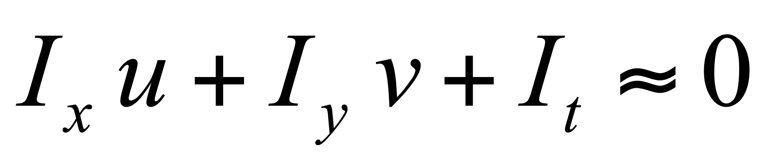
The brightness constancy constraint
I(x,y,t–1)
I(x,y,t)
Brightness Constancy Equation:
Derivative in y direction
Linearizing the right side using Taylor expansion:
Derivative in time:
Therefore:
Source: S. Lazebnik

Slide 11
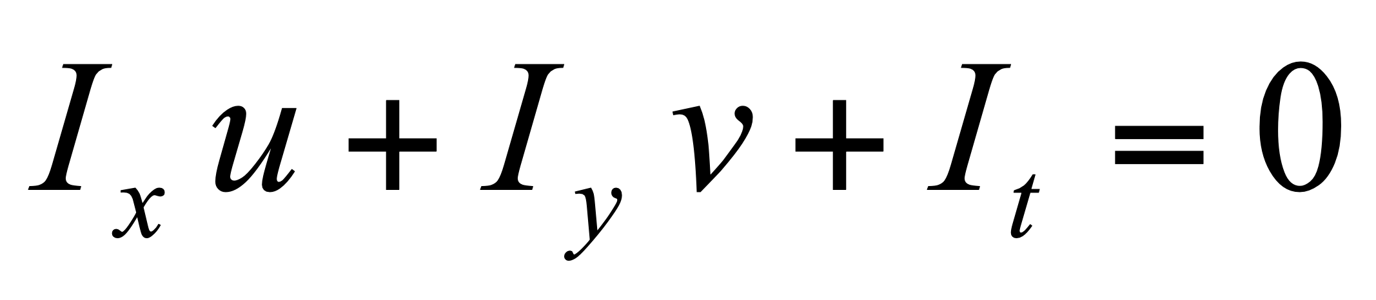
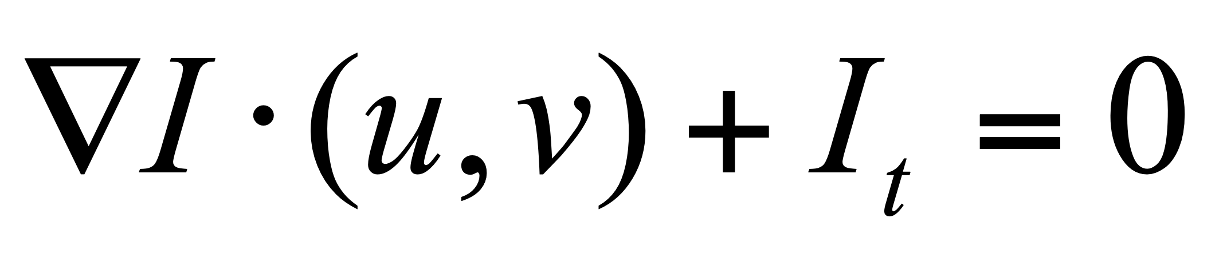
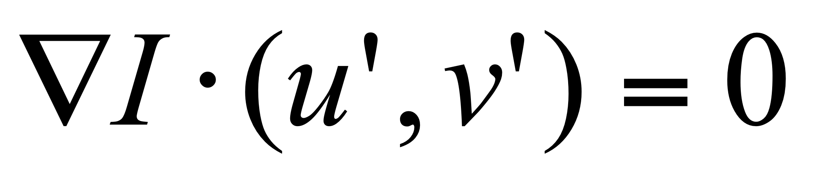
The brightness constancy constraint
How many equations and unknowns per pixel?
  One equation, two unknowns
Under-constrained. Let’s rewrite it:
The component of the flow perpendicular to the image gradient (i.e., parallel to the edge) is unknown!
gradient
(u,v)
  If (u, v) satisfies the equation,
  so does (u+u’, v+v’) if
(u’,v’)
(u+u’,v+v’)
edge
Source: S. Lazebnik
Notes:
A: u and v are unknown, 1 equation

Slide 12
The aperture problem
Perceived motion
Source: S. Lazebnik

Slide 13
The aperture problem
Actual motion
Source: S. Lazebnik

Slide 14

The barber pole illusion
http://en.wikipedia.org/wiki/Barberpole_illusion
Source: S. Lazebnik

Slide 15

The barber pole illusion
http://en.wikipedia.org/wiki/Barberpole_illusion
Source: S. Lazebnik

Slide 16
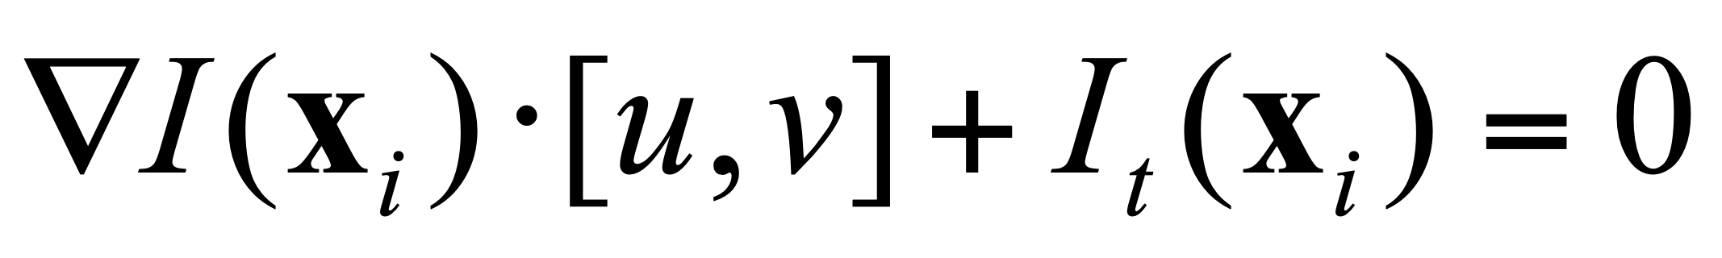
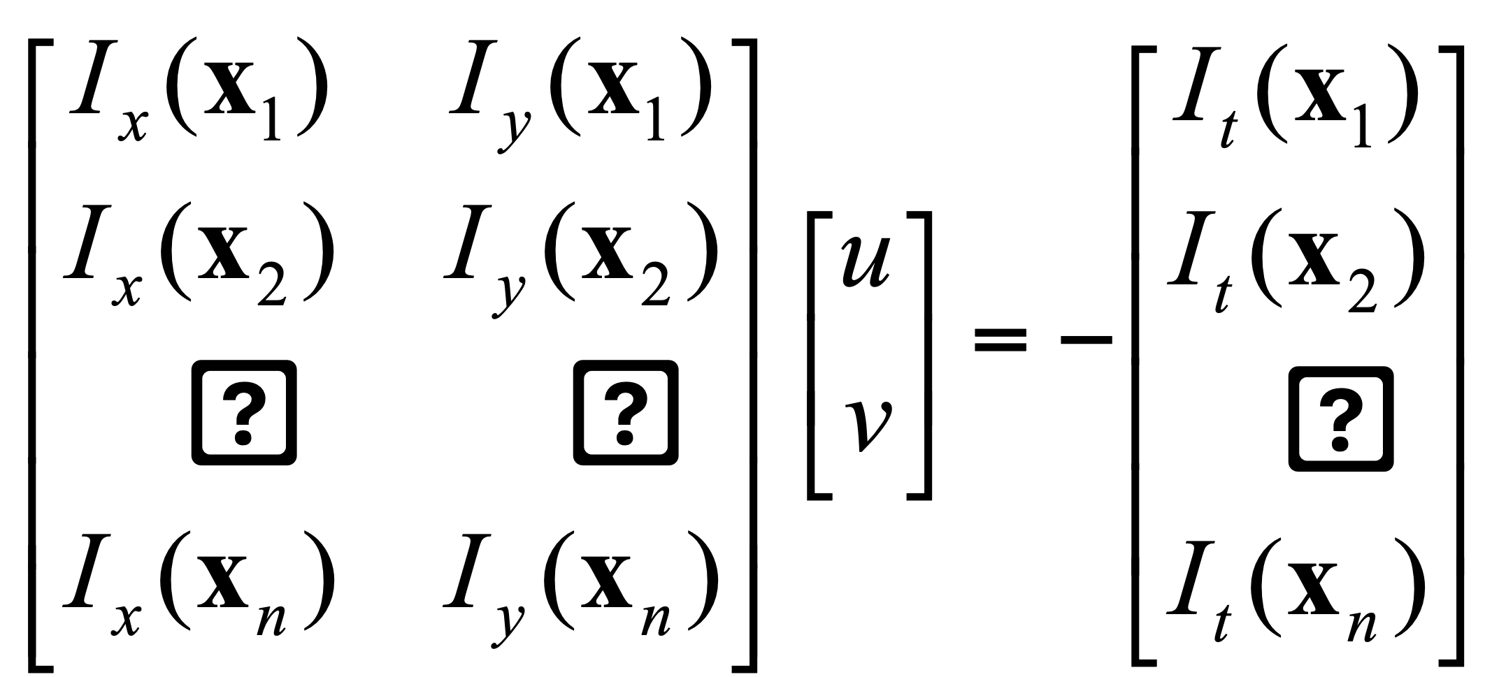
Solving the aperture problem
How to get more equations for a pixel?
Spatial coherence constraint: assume the pixel’s neighbors have the same (u,v)
  E.g., if we use a 5x5 window, that gives us 25 equations per pixel
…
…
…
[Lucas & Kanade 1981]
Source: S. Lazebnik

Slide 17
Lucas-Kanade flow
Least squares problem:
…
…
…
When is this system solvable?
[Lucas & Kanade 1981]
Source: S. Lazebnik

Slide 18
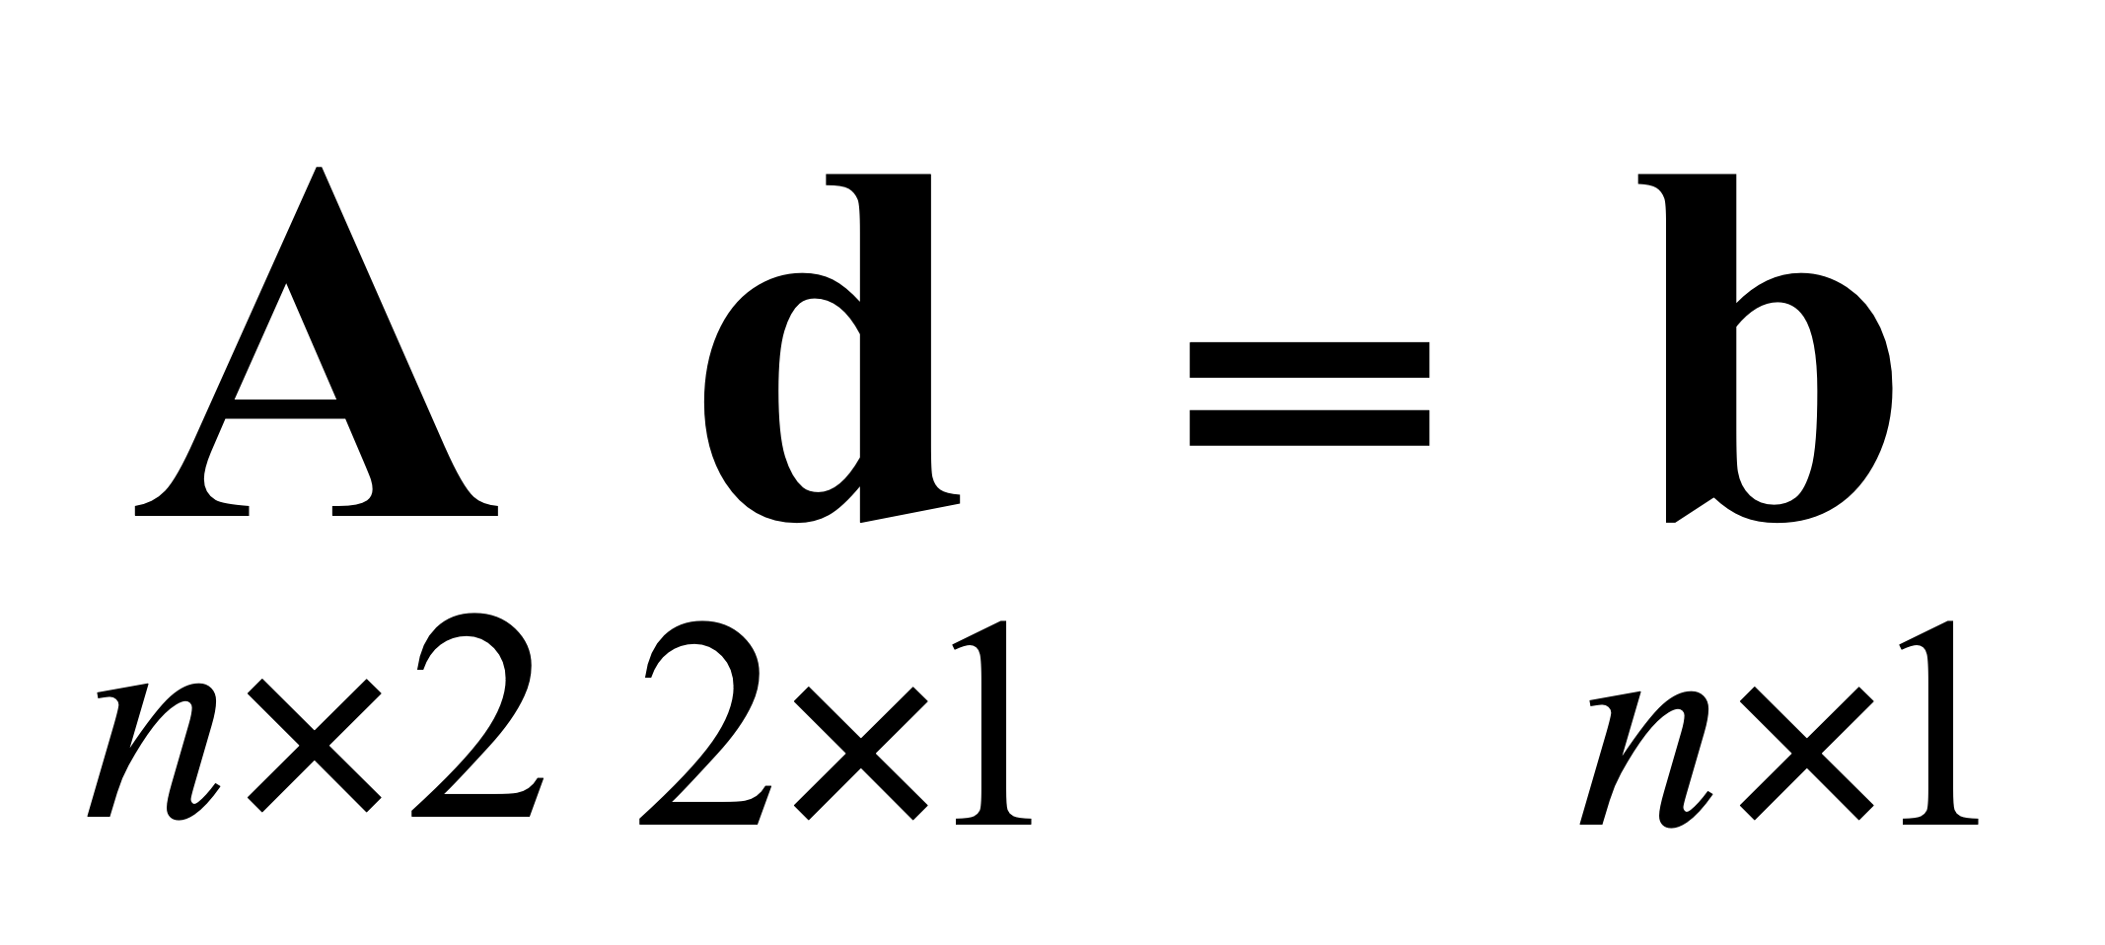
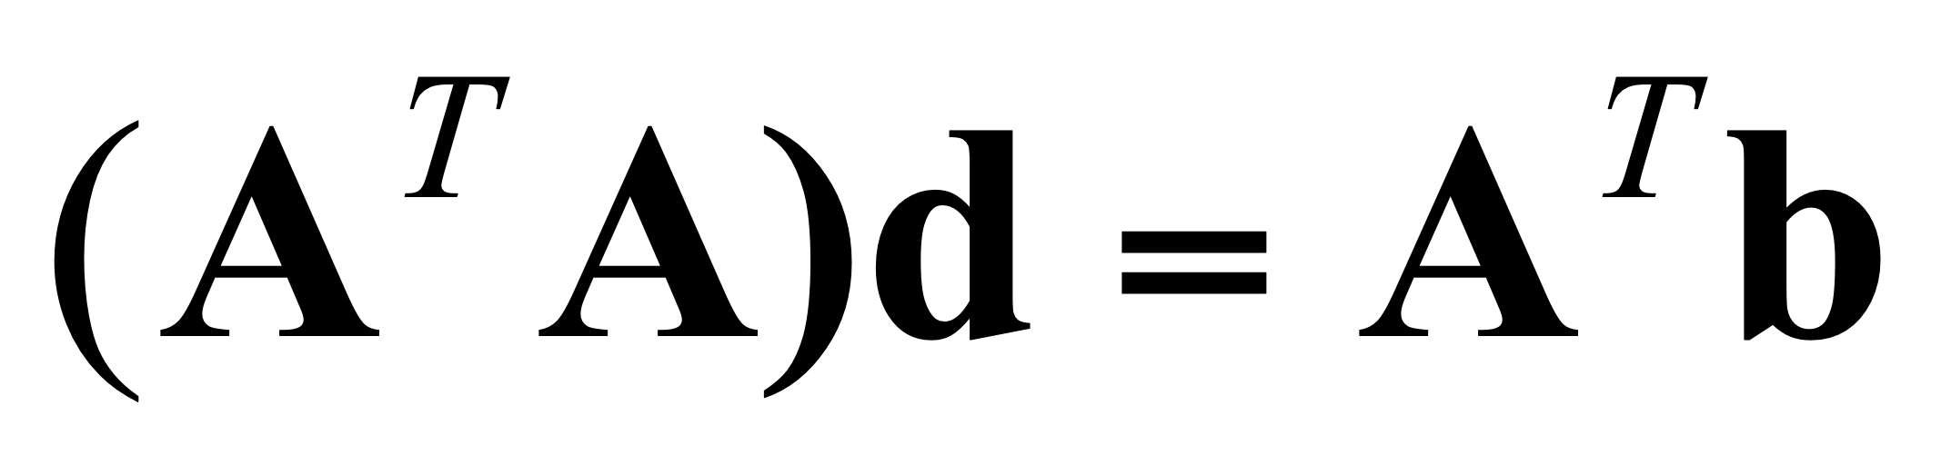
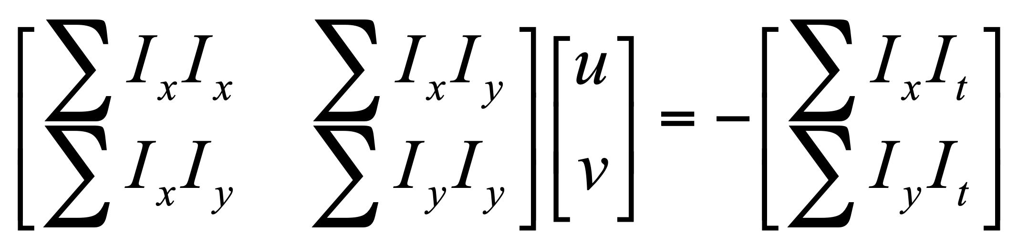
Lucas-Kanade optical flow
…
…
…
Solution given by
M = A^{T}A is the
“second moment” matrix
(also Gauss-Newton approximation to Hessian)
  (summations are over all pixels in the window)
[Lucas & Kanade 1981]
Source: S. Lazebnik

Slide 19
Analyzing the second moment matrix
Estimation of optical flow is well-conditioned precisely for regions with high “cornerness”:
λ₂
“Edge”
λ₂ >> λ₁
“Corner”
λ₁ and λ₂ are large,
λ₁ ~ λ₂
Eigenvalues
of M
λ₁ and λ₂ are small
“Flat” region
“Edge”
λ₁ >> λ₂
λ₁
Source: S. Lazebnik

Slide 20

Conditions for solvability
Bad case: single, straight edge
Source: S. Lazebnik

Slide 21
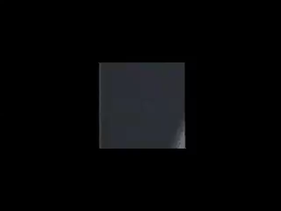
Conditions for solvability
Good case
Source: S. Lazebnik

Slide 22
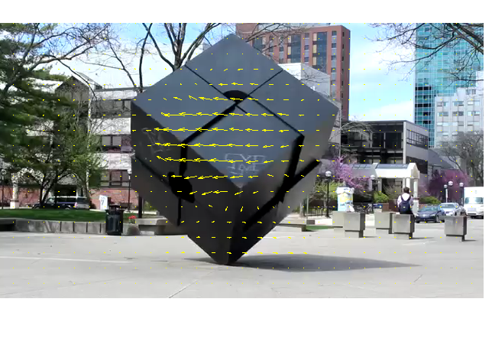
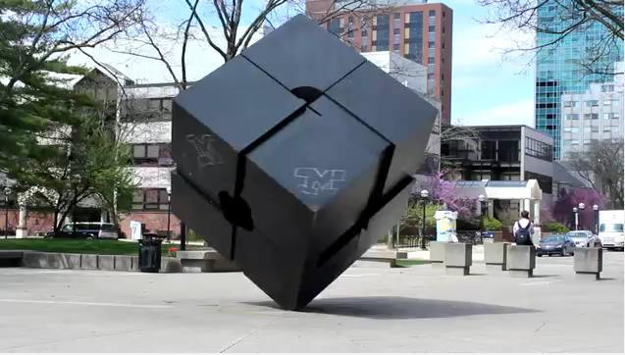

Lucas-Kanade flow example
Input frames
Output
Source: MATLAB Central File Exchange
Source: S. Lazebnik

Slide 23
Fixing the errors in Lucas-Kanade
The motion is large (larger than a pixel)
  Iterative refinement
  Multi-resolution (coarse-to-fine) estimation
Local ambiguity
  Smooth using graphical model refinement
Source: S. Lazebnik
Notes:
Iterative refinement:
Estimate velocity at each pixel using one iteration of Lucas and Kanade estimation
Warp one image toward the other using the estimated flow field
Refine estimate by repeating the process

Slide 24
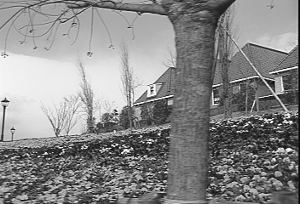
Large motions
Source: Khurram Hassan-Shafique CAP5415 Computer Vision 2003

Slide 25

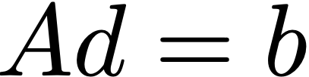
Idea #1: iterative estimation
  Goal: minimize matching error
  where the window width/height is 2N+1
  Iterative algorithm:
Initialize flow: u₀(x, y) = v₀(x, y) = 0
        For each iteration i:
            Linearize around current solution. Find an update for problem:
            by solving linear least squares problem for each pixel:
            Apply updates: and
Notes:
\sum_{x, y}[I(x, y, t-1) - I(x, u(x, y)), y + v(x, y), t)]^2
\mathcal{L}(u, v) = \sum_{x, y}\sum_{x' \in W(x), y' \in W(y)}[I(x', y', t-1) - I(x' + u(x, y), y' + v(x, y), t)]^2
\mathcal{L}(u, v) = \sum_{x, y}\sum_{x' = x - N}^{x + N} \sum_{y' = y - N}^{y + N}[I(x', y', t-1) - I(x' + u(x, y), y' + v(x, y), t)]^2
\sum_p[I_1(p) - I_2(p)]^2
u_{i+1} = u_i + \Delta u, v_{i+1} = v_i + \Delta v
\Delta u, \Delta v = \min_{\Delta u, \Delta v} \mathcal{L}(u_i + \Delta u, v_i + \Delta v)

Slide 26
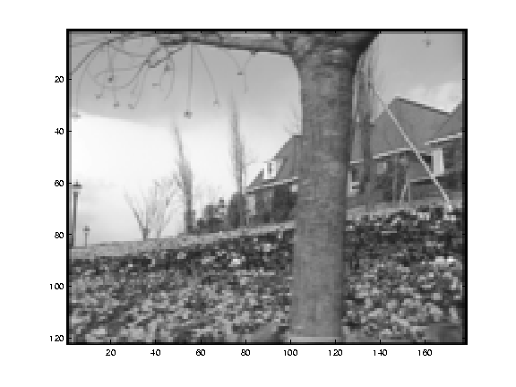
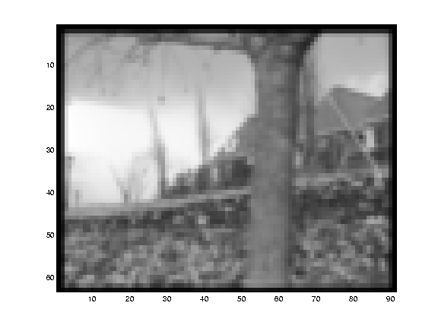
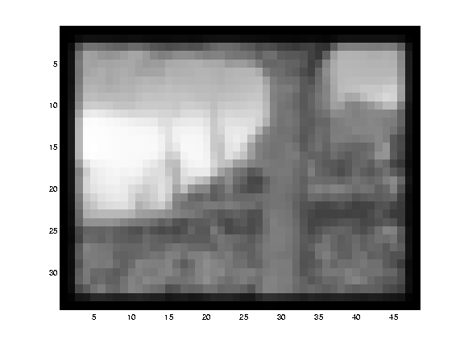
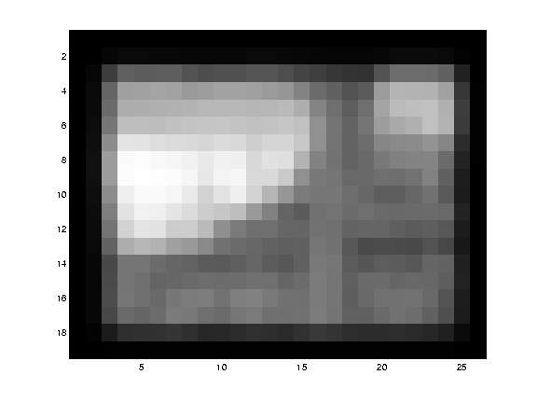
Idea #2: Multi-scale estimation
Source: Khurram Hassan-Shafique CAP5415 Computer Vision 2003

Slide 27
Idea #2: Multi-scale estimation
2x flow magnitude
Initialize flow: u₀(x, y) = v₀(x, y) = 0
For each scale s of Gaussian pyramid:
  Initialize flow from previous (coarser) scale
2x scale
                For each iteration i:
            Linearize around current solution. Find an update for problem:
            by solving linear least squares problem for each pixel:
            Apply updates: and
            Extra trick for smoother flow: apply median filter to u_{i+1} and v_{i+1}
Solve:
Notes:
\sum_{x, y}[I(x, y, t-1) - I(x, u(x, y)), y + v(x, y), t)]^2
\mathcal{L}(u, v) = \sum_{x, y}\sum_{x' \in W(x), y' \in W(y)}[I(x', y', t-1) - I(x' + u(x, y), y' + v(x, y), t)]^2
\mathcal{L}(u, v) = \sum_{x, y}\sum_{x' = x - N}^{x + N} \sum_{y' = y - N}^{y + N}[I(x', y', t-1) - I(x' + u(x, y), y' + v(x, y), t)]^2
\sum_p[I_1(p) - I_2(p)]^2
\Delta u, \Delta v = \min_{\Delta u, \Delta v} \mathcal{L}(u_i + \Delta u, v_i + \Delta v)

Slide 28
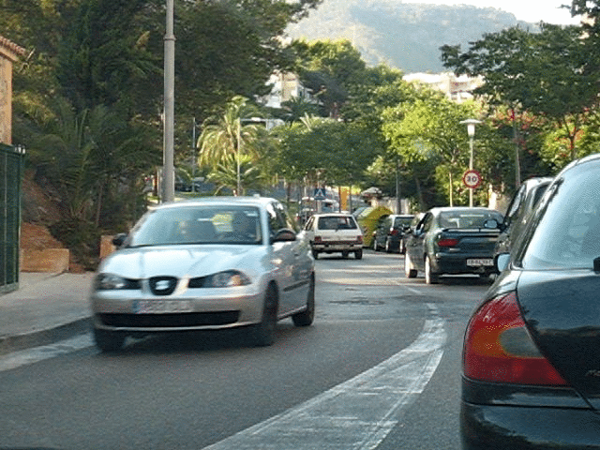
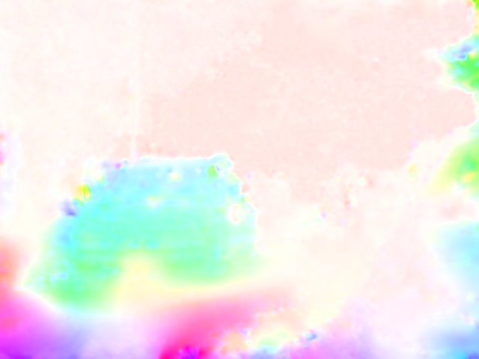
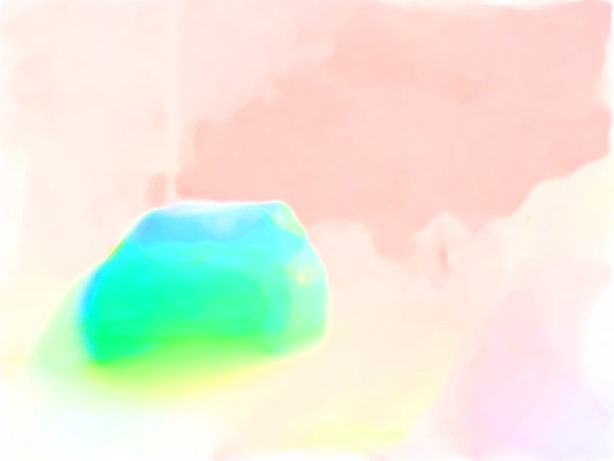
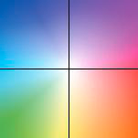
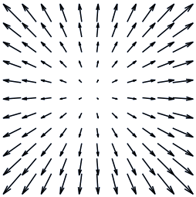
Example
Input two frames
Coarse-to-fine LK
Flow visualization
Coarse-to-fine LK with median filtering
Source: Ce Liu

Slide 29
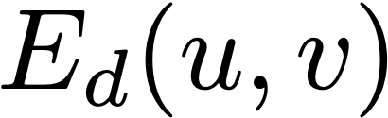
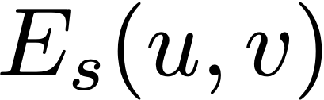
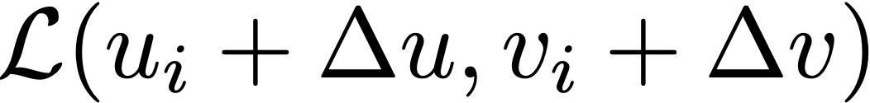
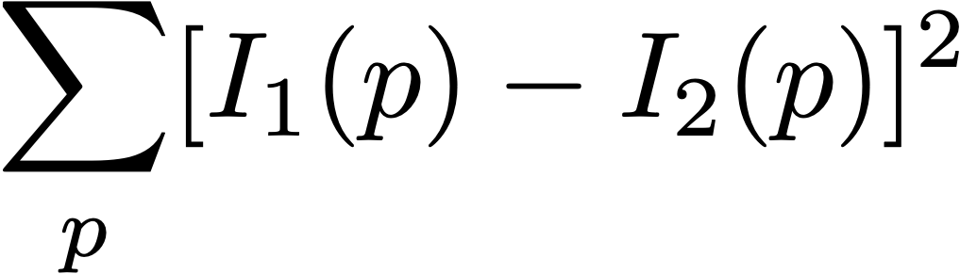
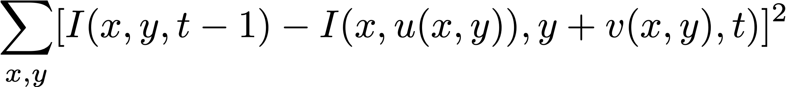
Smoothness assumption
  Goal: minimize matching error + smoothness [Horn and Schunck 1981]
  match cost
  smoothness
  where p and p’ are neighboring pixels
  Can solve using gradient descent or nonlinear least squares
1
Solve:
Notes:
\sum_{x, y}[I(x, y, t-1) - I(u(x), v(y), t)]^2 + \sum_{p} \sum_{p' \in \mathcal{N}} (u(p) - u(p'))^2 + (v(p) - v(p'))^2

Slide 30
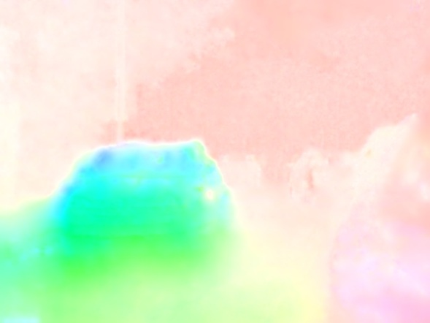
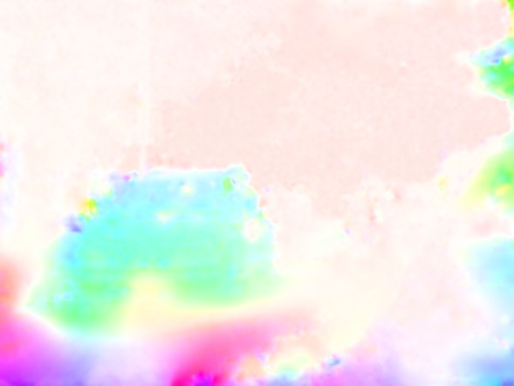
Smoothness assumption
Horn-Schunck
Input two frames
Flow visualization
Coarse-to-fine LK
Source: Ce Liu

Slide 31
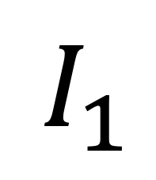
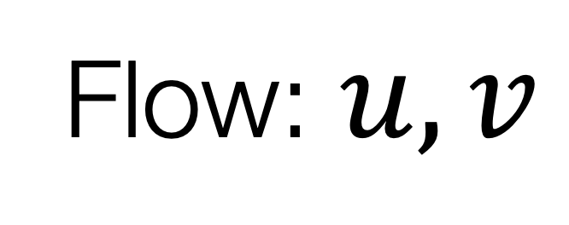

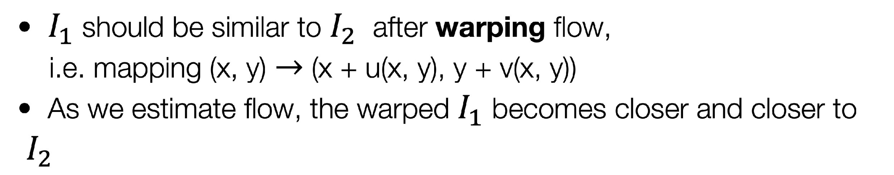
Warping
Warp image 1 to image 2

Slide 32
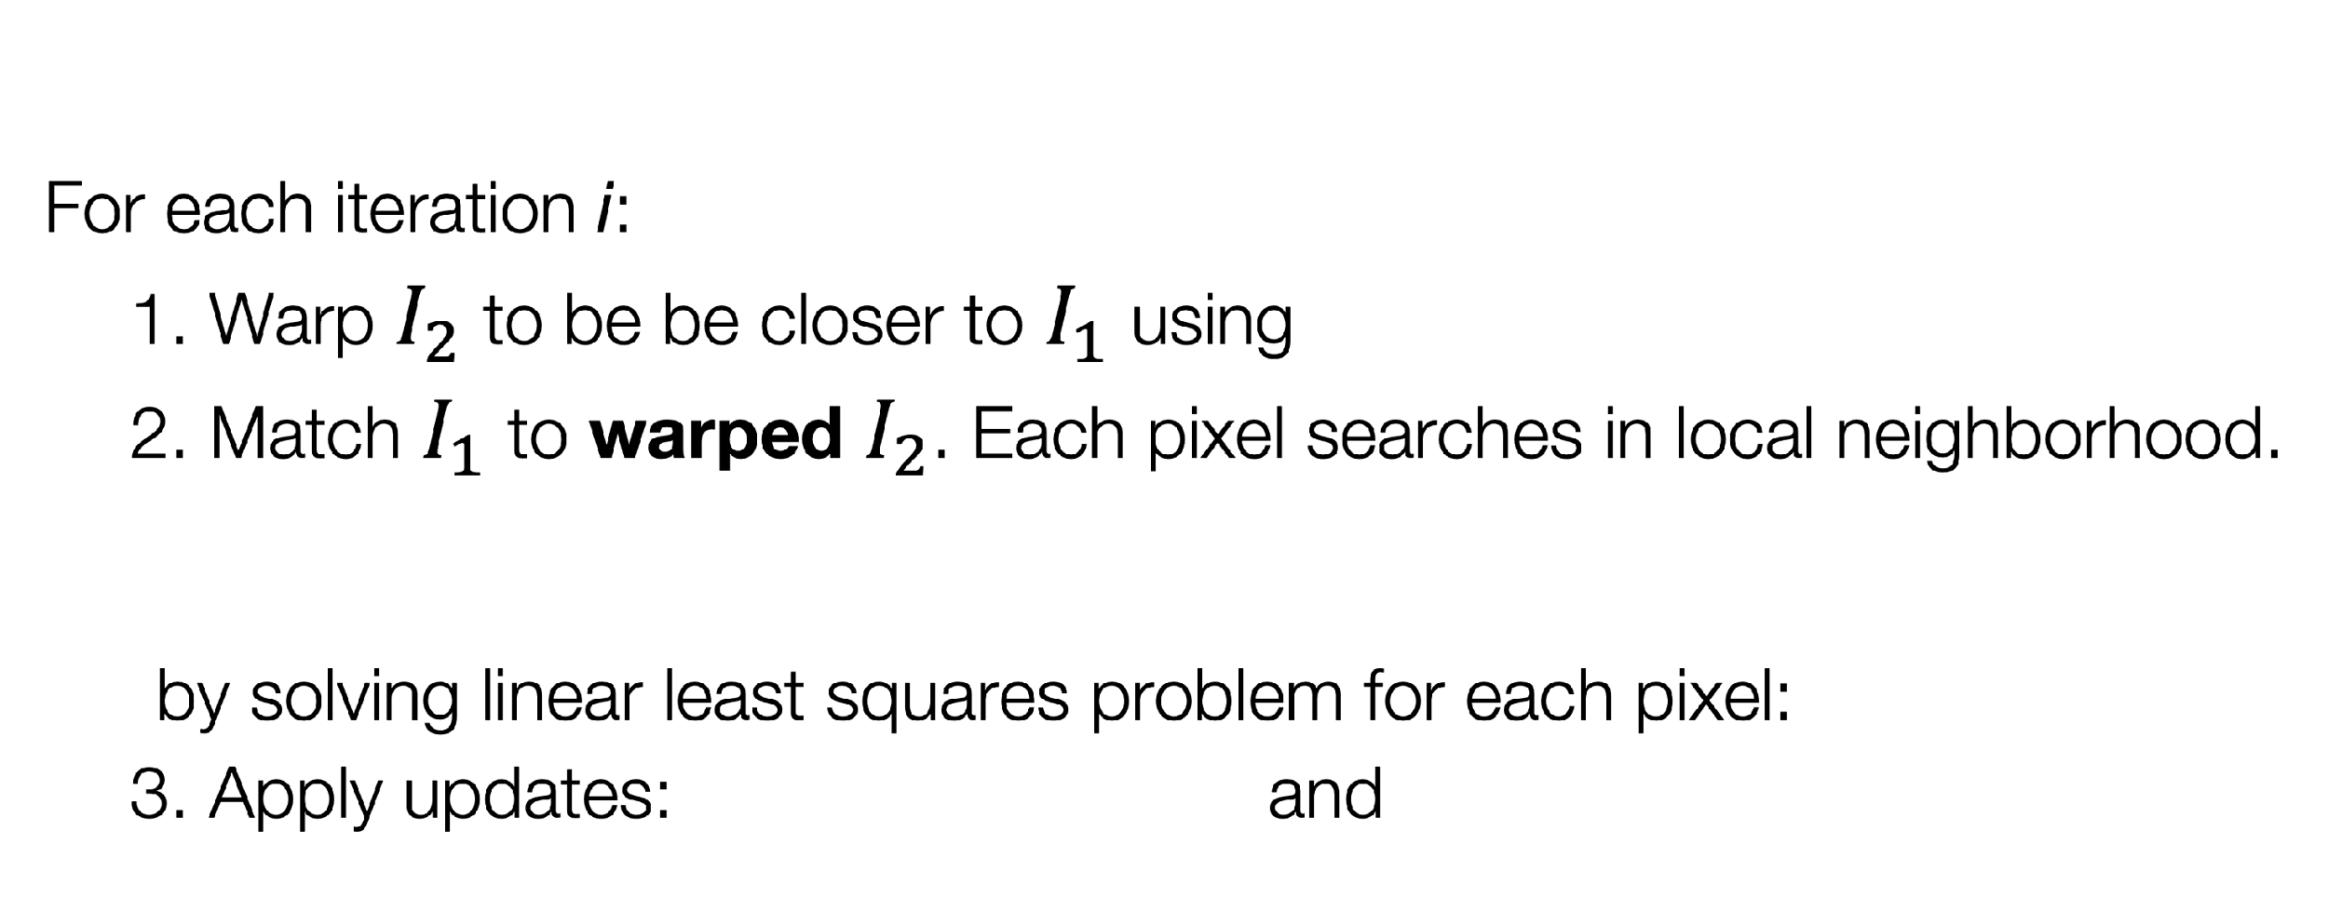
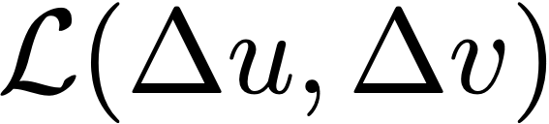
Flow with warping
Initialize flow: u₀(x, y) = v₀(x, y) = 0
For each scale s:
  Initialize flow from previous (coarser) scale
Solve:
Notes:
\sum_{x, y}[I(x, y, t-1) - I(x, u(x, y)), y + v(x, y), t)]^2
\mathcal{L}(u, v) = \sum_{x, y}\sum_{x' \in W(x), y' \in W(y)}[I(x', y', t-1) - I(x' + u(x, y), y' + v(x, y), t)]^2
\mathcal{L}(u, v) = \sum_{x, y}\sum_{x' = x - N}^{x + N} \sum_{y' = y - N}^{y + N}[I(x', y', t-1) - I(x' + u(x, y), y' + v(x, y), t)]^2
\sum_p[I_1(p) - I_2(p)]^2
\Delta u, \Delta v = \min_{\Delta u, \Delta v} \mathcal{L}(u_i + \Delta u, v_i + \Delta v)

Slide 33
Simple application: slow motion
  Flow used in lots of familiar places!
    E.g., video compression, denoising, action recognition, …
  One application: use flow to estimate where pixel will be between frames
  Synthesize intermediate frames
  (x + u, y + v) at time t
  (x, y) at time t-1
1
Solve:
Notes:
\sum_{x, y}[I(x, y, t-1) - I(u(x), v(y), t)]^2 + \sum_{p} \sum_{p' \in \mathcal{N}} (u(p) - u(p'))^2 + (v(p) - v(p'))^2

Slide 34
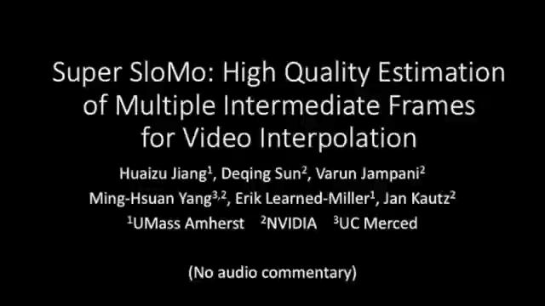

Slide 35
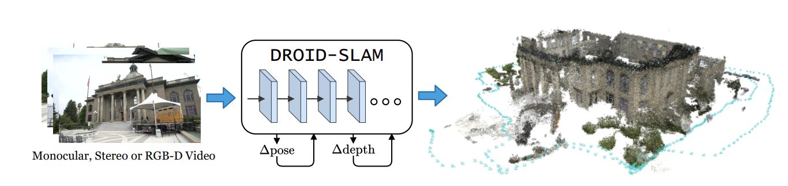
Structure from motion with flow
Use optical flow to find correspondences between frames.
Also called “passive structure from motion”
[Teed and Deng, 2021]

Slide 36
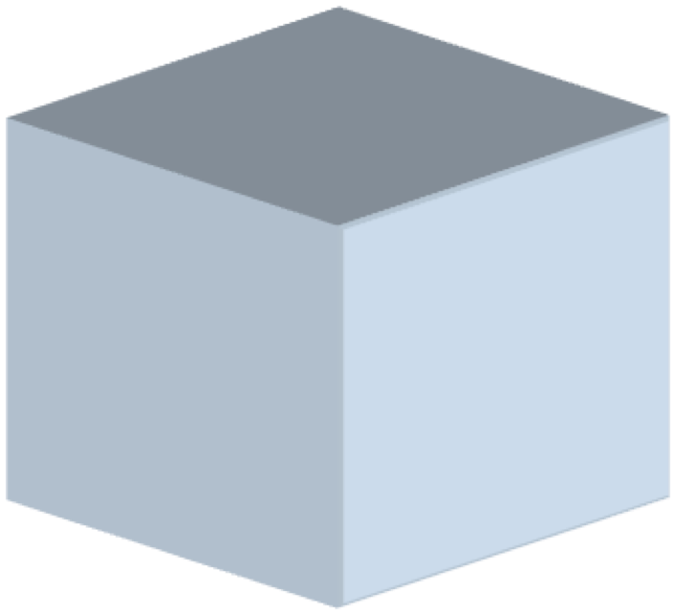
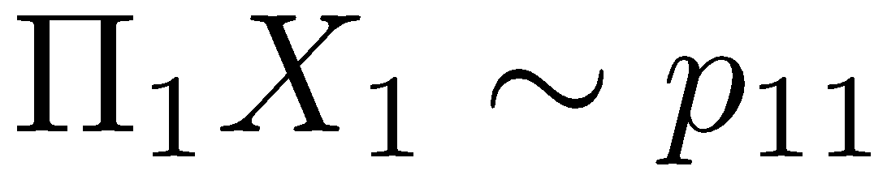
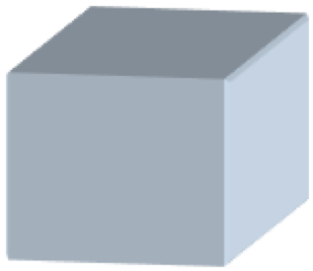


Passive Structure From Motion
X₄
X₁
X₃
The camera stay still but the scene moves
The same equations can estimate camera movement and depth!
X₂
X₅
X₇
X₆
p_{1,1}
p_{1,3}
p_{1,2}
Camera 1
Camera 3
R₁,t₁
R₃,t₃
Camera 2
R₂,t₂

Slide 37




Application: motion magnification.
enlarge tiny motions, making them easier to perceive [Liu et al., 2005].
https://dangeng.github.io/flowmag/
Zhaoying Pan
Daniel Geng
[Pan*, Geng*, Owens, “Self-Supervised Motion Magnification by Backpropagating Through Optical Flow”, NeurIPS 2023]
Notes:
always been fond of this original approach
optical flow already solves so much of this problem, is there some way to make use of this?

Slide 38





Motion magnification model
U-Net
Input frames
Magnified 2nd frame
[Geng, Pan, Owens, “Self-supervised Lagrangian Motion Magnification”, In Submission]
Notes:
One of the things that makes this exciting is that you can get very high quality stereo sound from consumer videos like iPhones
So we can show this here. Our method can track the location of sound sources. The y axis here is the time delay which is really close to angle.
Useful sound is also maybe a bit more ubiquitous than you’d think.
Here, We show qualitative examples from two iPhone videos. Y axis denotes the time delay which corresponds to angle

Slide 39


Magnification loss
Optical flow
Flow field
Notes:
One of the things that makes this exciting is that you can get very high quality stereo sound from consumer videos like iPhones
So we can show this here. Our method can track the location of sound sources. The y axis here is the time delay which is really close to angle.
Useful sound is also maybe a bit more ubiquitous than you’d think.
Here, We show qualitative examples from two iPhone videos. Y axis denotes the time delay which corresponds to angle

Slide 40

Magnification loss
Optical flow
Flow field
Notes:
One of the things that makes this exciting is that you can get very high quality stereo sound from consumer videos like iPhones
So we can show this here. Our method can track the location of sound sources. The y axis here is the time delay which is really close to angle.
Useful sound is also maybe a bit more ubiquitous than you’d think.
Here, We show qualitative examples from two iPhone videos. Y axis denotes the time delay which corresponds to angle

Slide 41

Motion magnification loss
1
Notes:
One of the things that makes this exciting is that you can get very high quality stereo sound from consumer videos like iPhones
So we can show this here. Our method can track the location of sound sources. The y axis here is the time delay which is really close to angle.
Useful sound is also maybe a bit more ubiquitous than you’d think.
Here, We show qualitative examples from two iPhone videos. Y axis denotes the time delay which corresponds to angle

Slide 42
Motion magnification loss
magnification factor
1
Backprop through the optical flow during training!
Notes:
One of the things that makes this exciting is that you can get very high quality stereo sound from consumer videos like iPhones
So we can show this here. Our method can track the location of sound sources. The y axis here is the time delay which is really close to angle.
Useful sound is also maybe a bit more ubiquitous than you’d think.
Here, We show qualitative examples from two iPhone videos. Y axis denotes the time delay which corresponds to angle

Slide 43

Motion magnification loss
1
Notes:
One of the things that makes this exciting is that you can get very high quality stereo sound from consumer videos like iPhones
So we can show this here. Our method can track the location of sound sources. The y axis here is the time delay which is really close to angle.
Useful sound is also maybe a bit more ubiquitous than you’d think.
Here, We show qualitative examples from two iPhone videos. Y axis denotes the time delay which corresponds to angle

Slide 44
Motion magnification loss
1
Notes:
One of the things that makes this exciting is that you can get very high quality stereo sound from consumer videos like iPhones
So we can show this here. Our method can track the location of sound sources. The y axis here is the time delay which is really close to angle.
Useful sound is also maybe a bit more ubiquitous than you’d think.
Here, We show qualitative examples from two iPhone videos. Y axis denotes the time delay which corresponds to angle

Slide 45

Motion magnification loss
1
1
Notes:
generate video by magnifying every frame with respect to the first frame in the video

Slide 46
Next lecture: machine learning

Slide 47




Coarse-to-fine refinement
Lucas-Kanade is a greedy algorithm that converges to local minimum
Initialization is crucial: if initialized with zero, then the underlying motion must be small
If underlying transform is significant, then coarse-to-fine is a must
Smooth & down-sampling

Slide 48



Feature tracking
C. Tomasi and T. Kanade. Shape and motion from image streams under orthography:
A factorization method. IJCV, 9(2):137-154, November 1992.

Slide 49
Feature tracking
Like in SIFT feature matching, only track distinctive regions
Small motion assumption: search only in small window

Slide 50

Tracking example
J. Shi and C. Tomasi. Good Features to Track. CVPR 1994.

